Slide 1
GC7 Guidance for Funding Requests: Malaria
Updates for the 2023-2025 Allocation Period
Zambia Country Dialogue
January 23- February 1, 2023

Slide 2
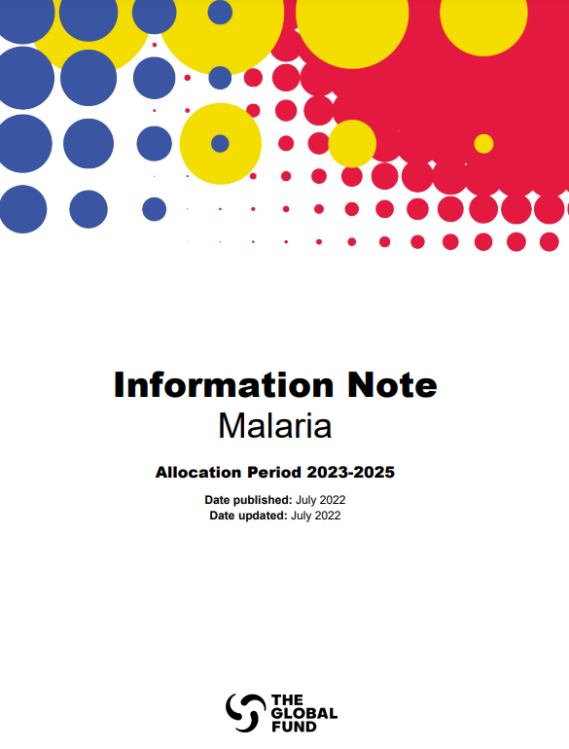
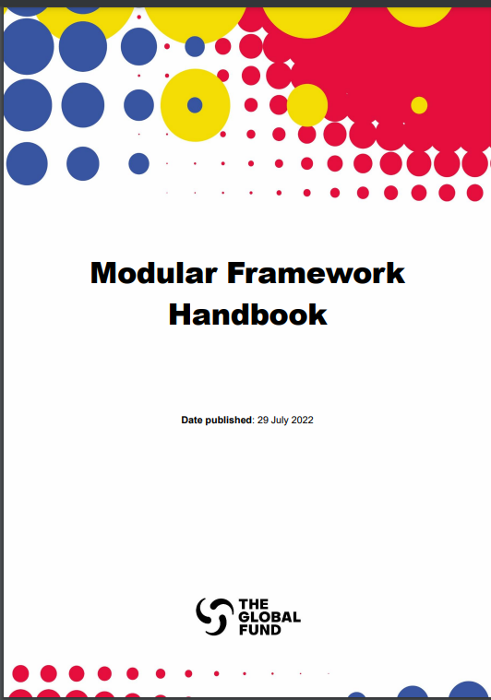
Key Malaria Resources for Funding Requests:
2023-2025 Allocation Period
Malaria Information Note
The RSSH, HIV and TB Information Notes are also available here.
Additional Resources
1. Technical Briefs
Technical Briefs published here
2. Global Guidelines
Links to all key technical guidance documents are in footnotes of the Malaria Information Note.
Modular Framework
This resource includes details on Global Fund-supported interventions and indicators.

Slide 3
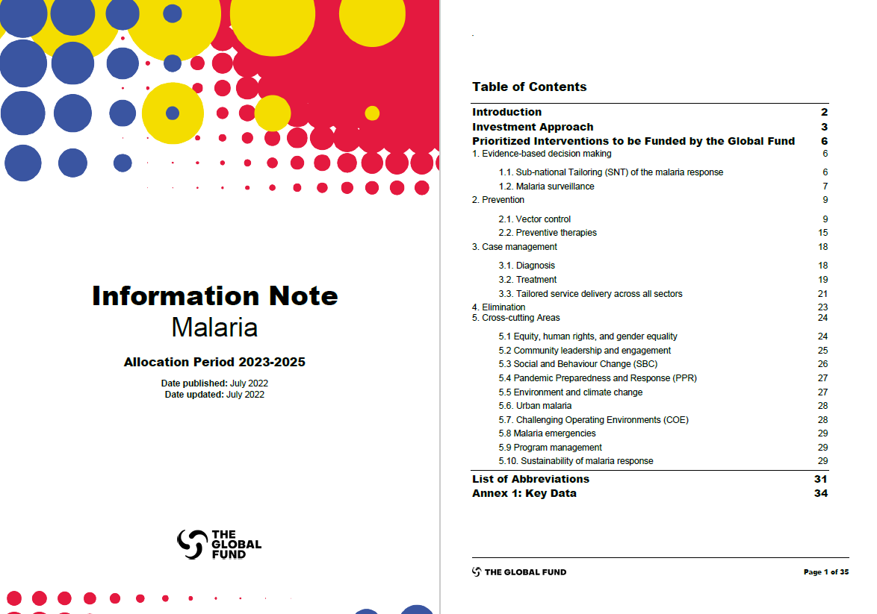
Malaria Information Note
Allocation Period 2023-2025
The Malaria Information Note is available here.
Purpose:
Complements normative guidance to assist with preparation of the funding requests.
Provides recommendations on priority interventions and strategic investments aligned to NSPs to achieve impact.
Includes Global Fund considerations around program essentials, procurement and supply chain management and other requirements

Slide 4
Malaria Investment Areas
1
Equity, Gender Equality and Human Rights
Evidence-based Decision-making
Cross-cutting Considerations:
Community Leadership and Engagement
2
Social and Behavior Change (SBC)
Vector Control
Pandemic Preparedness and Response (PPR)
3
Environment and Climate Change
Preventative Therapies
Urban Malaria
4
Challenging Operating Environments (COE)
Case Management
Malaria Emergencies
5
Program Management
Malaria Elimination
Sustainability of Malaria Response

Slide 5
Investment Approach
TRP Considerations
Key messages on investment areas

Slide 6
Investment Approach
Malaria
Overarching
TRP Considerations for malaria grants
“Carefully prioritize modules and the highest impact interventions within the specific country context, including focus on populations with elevated risks of infection and exposure, and related social determinants, rather than spreading the Global Fund investments thinly across too many modules and interventions with limited potential for sustainability and value for money”.
Priority on ensuring high coverage and quality of core malaria interventions
Resources are constrained: request from TRP for funding requests to clearly articulate prioritization approach, justification based on what criteria, data and intended impact.
https://www.theglobalfund.org/en/technical-review-panel/reports/
Malaria funding requests should be strategically focused on delivering optimal intervention mixes that are cost-effective and tailored to country context- sub-national tailoring (SNT)
Investments in Resilient and Sustainable Systems for Health (RSSH) to ensure achievement of malaria outcomes: while thinking through each malaria intervention, consider the health systems elements crucial for success​
Notes:
Every malaria funding requests should be strategically focused on delivering optimal intervention mixes that are cost-effective and tailored to country context​
understanding what service is needed where, when and how best to deliver the service to the targeted individual/populations in a way that will maximize impact:​ ​
Health System: what key governance, financing, health product management, human resource, data, laboratory and community components and systems do the success of malaria intervention implementation depend on?​
Contextual: what legislation, socio/cultural/economic, (in)security, environmental, geographic and political factors present opportunities or challenges to improving malaria service delivery? Are there factors at national level that are different at sub-national, local, community and individual level?​
Community: are there better/different/more ways to engage communities in delivery, monitoring, uptake of malaria services?​
Investments in Resilient and Sustainable Systems for Health (RSSH) are strongly encouraged to ensure achievement of malaria outcomes, which may include:
Identifying and addressing gaps in key services at primary health care level.
Strengthening health workforce.
Strengthening generation and use of data.
Strengthening national supply chain management .
Fostering people- and population-centered service delivery.
Strengthening community systems.

Slide 7
Evidence-based Decision-making
Support in-country capacity for sub-national tailoring and evidence-based prioritization of malaria interventions.
Build capacity for quality data generation, analysis and use at national and sub-national levels.
Ensure sub-nationally tailored planning considers factors beyond malaria epidemiology.
Deliver all interventions in a people-centered manner.
Ensure quality of all commodities and monitor effectiveness.
Eligible activities include:
Sub-national Tailoring
Creation, maintenance, and use of malaria data repositories, interoperable with existing information and able to draw from routine surveillance.
Short- and long-term capacity building of national and district malaria programs.
Digital health infrastructure including inventory of digital systems/assets, system standards and interoperability​
Malaria surveillance and Burden assessment
Health Management Information System (HMIS)-routine systems strengthening, digital data systems (public/private), readiness/maturity assessment & costed workplans, national strategies and governance mechanisms​
Consideration for program evaluation/OR to inform delivery, coverage and effectiveness of interventions*
Small scale surveys on intervention coverage/disease burden (ex. ANC- or school-based, sub-national, LQAS)​
Household surveys, such as DHS, MICS and MIS ​
Establishment and operationalization of malaria sentinel surveillance​ *https://www.insightsmalaria.org/research-prioritization
RSSH Investment
Notes:
*Refers to PMI supported initiative, with GF/BMGF to identify country-driven research priorities to address the most pressing evidence gaps and operational bottlenecks in malaria control and elimination.

Slide 8
Vector Control
Promote evidence-based prioritization for product selection, implementation modality, and timing and frequency of delivery.
Expand entomological surveillance.
Address barriers hampering the rapid scale-up of new products.
Evolve indicators to improve the tracking of effective vector control coverage.
Funding requests for vector control should be based on a national vector control strategy, using up-to-date entomologic and epidemiologic data and in line with the WHO Guidelines for Malaria.
Applicants should have a national ITN strategy, and the funding request should indicate both i) full need to achieve and maintain optimal effective coverage, with rationale and ii) the actual ask, with rationale, if more limited than the full need.
Indoor Residual Spraying (IRS) is eligible for funding if the applicant demonstrates sustainable financing to continue IRS, a sound insecticide-resistance management strategy and health and environmental compliance safeguards.
Surveillance and control of Anopheles stephensi should be included where appropriate.
Entomological surveillance should be prioritized, and requested if not available from other sources, which may include insecticide resistance, and associated IR management planning. Support for DHIS2 vector module integration can be included and is encouraged. ITN durability monitoring should be included.
Vector control needs assessments, and vector control and surveillance capacity building activities can be included.
Supplementary interventions: i.e., larval source management and house screening. Applicants should demonstrate (with data) that this intervention is appropriate to the setting and will not impact ability to fund ITNs/IRS at appropriate scale.
Interventions currently not recommended by WHO are not eligible for funding, which includes topical repellents, space spraying, insecticide treated clothing, insecticide treated plastic sheeting.

Slide 9
Vector Control (2)
Promote evidence-based prioritization for product selection, implementation modality, and timing and frequency of delivery.
Expand entomological surveillance.
Address barriers hampering the rapid scale-up of new products.
Evolve indicators to improve the tracking of effective vector control coverage.
Funding requests for vector control should be based on a national vector control strategy, using up-to-date entomologic and epidemiologic data and in line with the WHO Guidelines for Malaria.
Applicants should have a national ITN strategy, and the funding request should indicate both i) full need to achieve and maintain optimal effective coverage, with rationale and ii) the actual ask, with rationale, if more limited than the full need
Indoor Residual Spraying (IRS) is eligible for funding if the applicant demonstrates sustainable financing to continue IRS, a sound insecticide-resistance management strategy and health and environmental compliance safeguards.
Entomological surveillance should be prioritized, and requested if not available from other sources, which may include insecticide resistance, and associated IR management planning. Support for DHIS2 vector module integration can be included and is encouraged. ITN durability monitoring should be included.
.

Slide 10
Preventive Therapies (1/2)
Data driven intervention selection and implementation modality.
Flexibility on implementation strategies including integration within primary healthcare as relevant.
Applicants are strongly encouraged to:
Prioritize interventions based on available evidence, local epidemiology, transmission intensity, seasonality, and access to services.
Strengthen interactions between different types of chemoprevention should be assessed prior to implementation.
New – support WHO recommendations on seasonal malaria chemoprevention (SMC) age/location/rounds. Applicants should provide relevant data and monitoring and evaluation activities (pharmacovigilance and drug resistance); and strategies to improve service delivery.
Support intermittent preventive treatment of malaria in pregnancy through integrated systems approach in which the continuum of care for pregnant women is reinforced.
Integrate Perennial Malaria Chemoprevention, previously Intermittent Preventive Treatment for infants (IPTi), with other strategies targeting the same age group populations and closely monitored for coverage and impact.
New - Support intermittent preventive treatment for school children (IPTsc) and post discharge malaria chemoprevention (PDMC), if sufficient evidence has been provided.

Slide 11
Preventive Therapies (2/2)
Data driven intervention selection and implementation modality.
Flexibility on implementation strategies including integration within primary healthcare as relevant.
Mass Drug Administration:
  Can be used for: (a) emergency burden reduction (including malaria outbreaks and malaria control in emergency settings); or (b) transmission reduction in the context of intensified elimination efforts.
  Mass Drug Administration for elimination effect wanes in 1-3 months; it is recommended when combined with components of a robust malaria elimination program.
  New – Mass Relapse Prevention of Pv. with 8-aminoquinolines is currently not recommended by WHO.
New – Malaria Vaccines:
  WHO recommended the use of RTS,S/AS01 malaria vaccine should be used for the prevention of P. falciparum malaria in children living in regions with moderate to high transmission as defined by WHO.
  Malaria vaccine RTS,S/AS01 (RTSS) introduction requires a strong coordination between the national immunization program and the malaria control program and has to consider several factors such as: levels of malaria transmission at sub-national level, pattern of severe malaria, structure and function of the health system, use and coverage of existing malaria control interventions, and the context where the vaccine could best complement other tools as part of a package of interventions.
  The Global Fund does not support RTS,S/AS01 procurement and introduction, but the funding request can include technical support for subnational tailoring or National Strategic Plans (NSP) update and Malaria Program Reviews (MPR).

Slide 12
Case Management
Understand and address key barriers to access. Expand community platforms where access is low. Improve and evolve surveillance and data collection tools and processes to enable continuous quality improvement (CQI) and accurate surveillance. Strengthen coordination and linkages between public, private and community systems for service provision.
Diagnosis | Treatment | Tailored service delivery across all sectors
Applicants are encouraged to: Support early diagnosis of malaria, including testing suspected cases with microscopy or RDTs. Info note includes considerations for RDTs selection, procurement and quality assurance process Address Pfhrp2/3 gene deletions by supporting baseline and periodic surveys and the procurement of alternative RDTS in the setting of confirmed deletions. The Global Fund does not fund more sensitive diagnostic tools for routine case management. | Applicants are encouraged to: Enhance efforts to mitigate antimalarial drug resistance via strengthening drug efficacy surveillance, and consideration of approaches to diversify ACT availability and use in country. Strengthen management of severe malaria at the facility and community level, including attention to referral systems and adherence to guidelines Strengthen management of P.vivax by using primaquine for radical cure recommended with systems for detecting G6PD deficiency and/or for monitoring hemolysis. | Stratify key indicators for case management by district on a routine basis to assess performance, to guide quality of care interventions New – Strengthen private sector engagement and develop pathways to develop criteria on diagnostics to access funding ACT co-payment mechanisms. New - Integrate community case management interventions, including non-malaria iCCM commodities. Antibiotics for pneumonia (first line treatment in U5s only) ORS and zinc for diarrhea for U5s only

Slide 13
Case Management: Addressing Drug Resistance
In the context emerging artemisinin partial resistance in Africa, and in complement to the WHO Strategy in Addressing Antimalarial Drug Resistance, GF strongly supports countries to include interventions to mitigate the risks and respond to the emergence and spread of antimalarial drug resistance within the funding request.
Drug Efficacy Surveillance | Response | Market Shaping Interventions
Applicants are encouraged to: Invest to improve the scope, timeliness, and quality of data on drug efficacy and resistance surveillance Prioritize building capacity and implementation of TESs and contribute data to regional networks for coordination and mapping of drug resistance We expect to see TES support within malaria grants in complement to partner initiatives Conduct country assessments as outlined in the WHO DR strategy and invest accordingly along the four pillars including surveillance | To preserve the therapeutic lifespan of current ACTs, Global Fund will support: In countries with evidence of artemisinin partial resistance or decreased partner drug efficacy, support introduction of alternative ACTs to reduce pressure on and protect efficacy partner drugs. If no documented DR, consider proactive planning for diversification of ACTs to delay the emergence of resistance Diversification approaches need to be underpinned by clearly articulated strategies and implementation frameworks for introducing, managing, and documenting implementation and impact of multiple first lines in countries. | Global Fund and partners are actively working on market shaping interventions to increase the supplier base for all ACTs and their affordability and hence expand access to currently approved ACTs Applicants are encouraged to: Commence planning for country readiness for use of alternative ACTs, including registration, inclusion in treatment guidelines, coordination with PSM systems, etc. Programmatic gaps analysis (GF and RBM) revised to assist with optimal approach to ACT diversification, and prioritization and justification in the context of other interventions should be clearly outlined in the funding request

Slide 14
RSSH investments to support successful case management and prevention
Health Products Management Systems:
    Planning, quantification and procurement capacity
    Storage and distribution capacity, design & operations
    Regulatory/quality assurance
    Waste management
Human Resources for Health:
    HRH planning, management & governance – for improved distribution and retention of PHC workforce at subnational level
    Quality improvement, supportive supervision combined with training for integrated platforms.
    Competency based pre-service training
Data/Information systems: (see slides 9&10)
Digital platforms (private, community, facility, financial, supply chain)
HMIS strengthening
Geospatial mapping
M&E, surveillance, coverage surveys, etc.
Community system strengthening community led monitoring for PHC services; CBO/CLO engagement for service delivery, SBCC, assisted referrals
Laboratory strengthening as related to diagnosis and drug resistance surveillance
Health Financing Systems: strengthening of budgeting, financial management and accounting, etc.

Slide 15
Cross-cutting Areas (1/3)
Equity, Gender Equality and
Human Rights
Community Leadership and Engagement
Social and Behavior Change (SBC)
Equity, human rights, and gender equality considerations should be included in the sub-national tailoring analysis.
Disaggregation of data (e.g., gender, age, other equity-related variables) as needed to guide decision-making.
Include in the funding request background information on malaria-specific vulnerability and focus interventions accordingly.
Funding request should include an analysis of the data available to demonstrate any known barriers to access and uptake of malaria services.
Funding for implementation of the Malaria Matchbox or other similar tools can be included where EHRGE analyses have not been undertaken and/or information gaps exist.
Community Systems improve and monitor access to malaria services
Activities that empower and support communities' participation in national and local structures, platforms, and processes, as well as activities that ensure communities and civil society play a meaningful role in Global Fund grant application, decision-making, and implementation, are eligible for funding.
Community-led monitoring activities are eligible for funding.
Investments in SBC need to be evidence-based, results-oriented, theory-informed and part of the national malaria SBC strategy.
SBC plans and activities should build on existing best-practice and SBC efforts in other health sectors

Slide 16
Cross-cutting Areas (2/3)
Pandemic Preparedness and Response (PPR)
Environment and Climate Change
Urban Malaria
Health system components which respond to malaria are key in early identification and response to pandemics.
Investments in PPR can build on already existing systems, including malaria control and surveillance systems for acute febrile illness. Malaria early warning systems and laboratory system strengthening are eligible for funding.
When integrating applicants should assess the scope and readiness of the existing structures and ensure sufficient resources (e.g., training, support supervision, etc.) are available for successful service delivery.
Environmental factors including climate events and climate change disproportionally affect malaria.
Climate data is expected to be routinely incorporated in malaria data repositories and used as one of the factors to guide program planning, adaptations, and coverage. Integration of malaria into emergency response plans (epidemic, climate/natural disasters) should be considered, where relevant.
Waste management activities can be included for the relevant malaria interventions (e.g., vector control) and broader waste management and green technology for facilities should be budgeted under RSSH.
Built urban environment, such as urban agriculture, settlement construction, roads and water drainage systems, and exposed water channels, can have a significant impact on urban malaria risk and burden. Large-scale rural-to-urban migration frequently leads to the expansion of unplanned settlements and an increased socioeconomic inequity and increased risk to malaria.
Malaria transmission in urban areas is usually focal therefore a response targeting focal areas of transmission is likely more effective than an urban-wide approach. Geospatial and epidemiological surveillance and analysis, technical assistance to tailor malaria interventions to urban settings, community engagement, and support to initiatives to improve quality and reporting are eligible for funding.
Applicants are encouraged to document current practices and lessons learned

Slide 17
Cross-cutting Areas (3/3)
Challenging Operating Environments (COE)
Malaria Emergencies
Program Management
Sustainability of Malaria Response
COEs host less than 14% of the world’s population and account for approximately one-third of the global disease burden for HIV, TB and malaria. In conflict and following natural disasters, infectious diseases, lack of treatment and food insecurity can sometimes kill more people than the violence or crisis itself.
Activities to support adapted strategies (e.g., increasing the frequency of distributions to refugees, individual ITN distribution to displaced persons, selecting CHWs amongst mobile or migrant populations) are eligible for funding.
Flexibilities may be applicable to and are detailed in the Global Fund operational manual.
There is a mechanism to provide urgent funding for emergencies, including but not limited to, malaria outbreaks, natural disasters, and population displacement. This includes procurement of commodities to respond to urgent needs - see the guidelines on the Emergency Fund for details. Malaria emergencies can also be funded through reprogramming of funds within the malaria grants.
Funding request can include activities related to leadership, coordination, and management of the malaria program at national and subnational levels.
Special attention to capacity building for data generation, use and analysis at sub-national level.
Strengthening sustainability is critical. Financial sustainability is a critical priority, and sustainability considerations cut across many thematic areas, including epidemiological, programmatic, systems-related, governance, and human rights and vary according to the specific country context.

Slide 18
Key considerations in preparation for GC7
National strategic plans
Optimize current investments
Seize ongoing funding opportunities
Updated and costed national strategic plans
  Mid-term review (MTR)
  Quick review and update if plans are not due for MTR
    Emerging priorities
    New technologies
    Updated guidelines
  2. Optimize current grant implementation and seize opportunities for reinvestment
    Revise budget and reprogram savings to strengthen systems and interventions, aiming at
      Creating efficiencies and alleviate GC7 funds to better cover gaps in the strategic plans
        Procurement of laboratory equipment and health commodities
        Scale up and acceleration of key interventions
        Rollout of new interventions to gather proof of concept, for scale up in GC7
  3. Seize ongoing funding opportunities – C19RM mechanism
  Strengthen pandemic preparedness
  Integrated disease surveillance and response, including early warning and Events-based surveillance
  Strengthen community-led monitoring
  Mitigation of the impact of COVID on the 3 diseases
    Diagnosis network strengthening for dual screening (e.g.: mobile X-Rays and molecular diagnosis)

Slide 19
Key considerations in preparation for GC7
HIV program
TB program
Malaria program
  Expedite Rollout of delayed interventions
  KP clinics
  Population size estimates
    Finalize and use the ongoing size estimates and IBBS surveys
    Consider modeling and costing of coverage of interventions to optimize cost-effectiveness and impact
  AGYW programs
    Adaptive leadership
    Generation of evidence – improve outcomes in adolescent health
  1. Scale-up interventions from NFM 4
  Active case-finding
  Contact tracing
  Improving quality of TB and MDR-TB case finding
  2. TB laboratory optimization and strengthening
  Assessment TB diagnosis network
  Upgrading of existing TB diagnosis network
  Introduction and rollout of new diagnostics technology
  3. Strengthen integrated disease surveillance and response
  Strengthen preparedness and response in disaster situation to prevent exponential increase in malaria incidence
    Prepare for upcoming cyclones
Other cross-cutting issues
  Address ongoing global fund recommendations: OIG AMAs, TRP issues and others
  Seize opportunities for TA: modeling for HIV KPs, TB subnational estimates, malaria sub-national tailoring, laboratory network optimization

Slide 20
Thank you!

