Slide 1
Preparing for the 2023-2025 Allocation Period Grant Cycle 7
Zambia CCM: 24 January 2023

Slide 2
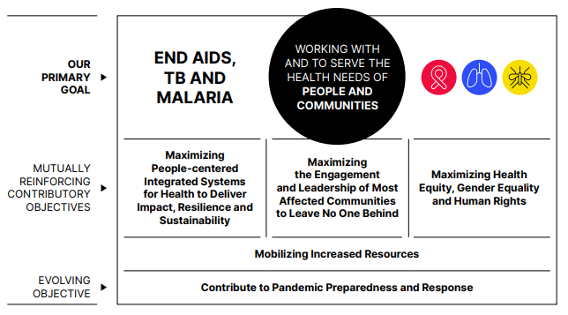
Global Fund Strategy 2023-2028
Fighting Pandemics and Building a Healthier and More Equitable World
Updated Forms
New Annexes
Evolved Expectations
Supporting country-owned programs to achieve national and global goals

Slide 3
2023-2025 Allocation Period Timeline
2022
2023
2024
2025
Q1 | Q2 | Q3 | Q4
Q1 | Q2 | Q3 | Q4
Preparation of FR templates, instructions, guidance materials
Published application materials (July)
E-learnings/Webinars/
Trainings (Sept-Dec)
Allocation letters
(Dec)
Funding Request Submissions (from March)
+ TRP review windows
Legend
FR application materials
Grant-making activities
Allocation letters
FR submission and review
Board Meetings
Grant Implementation
Grant-making
Replenishment Conference
Grant Implementation

Slide 4
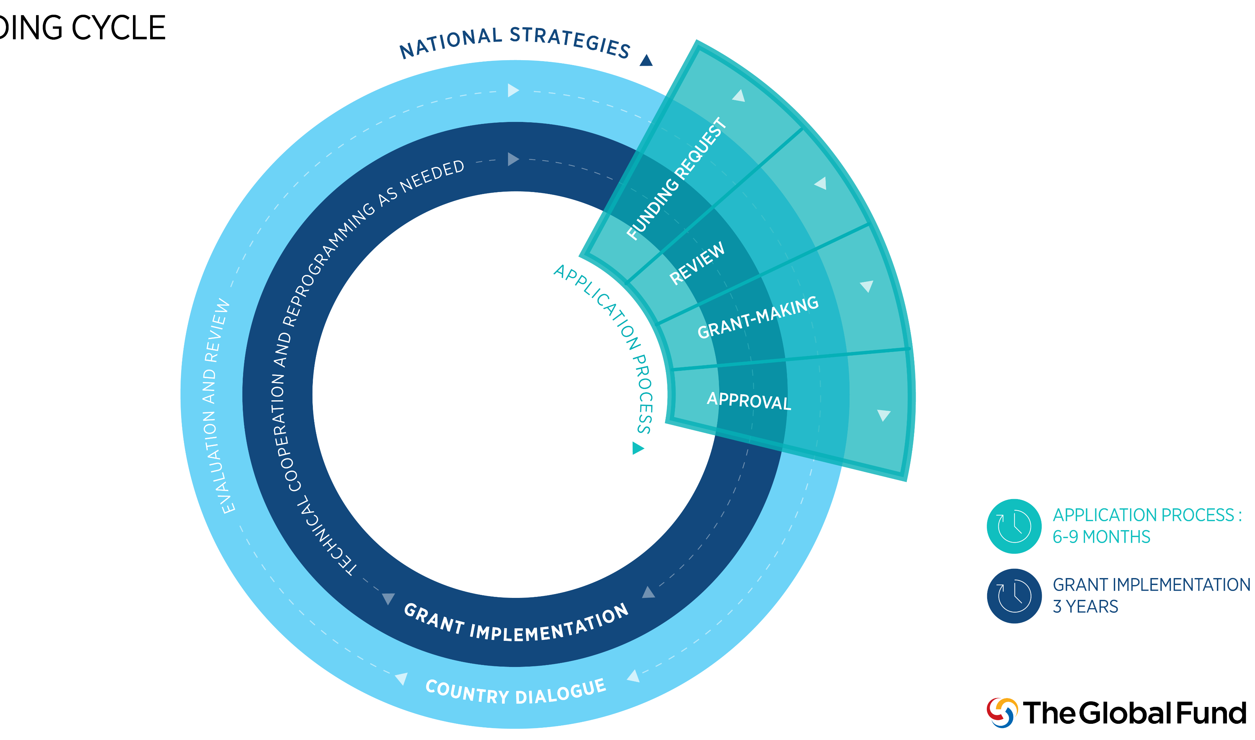
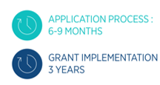
Applying for funding: No change to key process points
Program Split
Funding Request Submission
Screening
TRP Review
Grant Submission
GAC Review
Board Approval
Grant Signing
Grant Signing

Slide 5
2023-2025 Application Approaches
Key Changes for
2023-2025:
Full Review
Program Continuation
All templates adjusted to ensure alignment with new Strategy
All templates optimized to ensure questions are clear and to reduce duplication in responses
New mandatory annexes:
RSSH Gaps & Priorities
Funding Priorities from Civil Society & Communities
Country Dialogue Narrative
Core and High Impact
Countries
Tailored for National Strategic Plans
Tailored for Focused Portfolios
Tailored for Transition
Focused
Countries

Slide 6
Catalytic Investments: No change to three modalities
Matching funds
Catalytic Multicountry
Strategic initiatives
Designed to incentivize the use of country allocations for strategic priorities in line with the Global Fund and partner disease strategies.
Designed to target key, strategic multi-country (regional) priorities deemed as critical to meet the aims of the Global Fund Strategy and in line with global disease priorities.
Designed to provide limited funding for centrally managed approaches that cannot be addressed through country allocations alone due to their cross-cutting or off-cycle nature but are critical to ensure that country allocations deliver against the Global Fund Strategy

Slide 7
Matching Funds Priority Areas
Updated to reflect GAC decision on 2 December
Prevention for key populations, adolescent girls and young women, and sexual partners
Find and successfully treat the missing people with drug-susceptible and drug-resistant tuberculosis
Scaling-up programs to remove human rights- and gender-related barriers
Incentivizing RSSH quality and scale
Effective community systems and responses

Slide 8
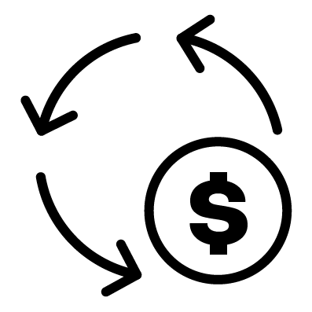
Content areas in Funding Requests
Rationale
Maximizing Impact
Implementation
Funding Request Prioritization
Strategic alignment
Implementation Arrangements
Country Context
Co-financing, Sustainability & Transition
Risk
Across the Funding Request
Human Rights and Gender
Value for Money
Opportunities for Integration

Slide 9
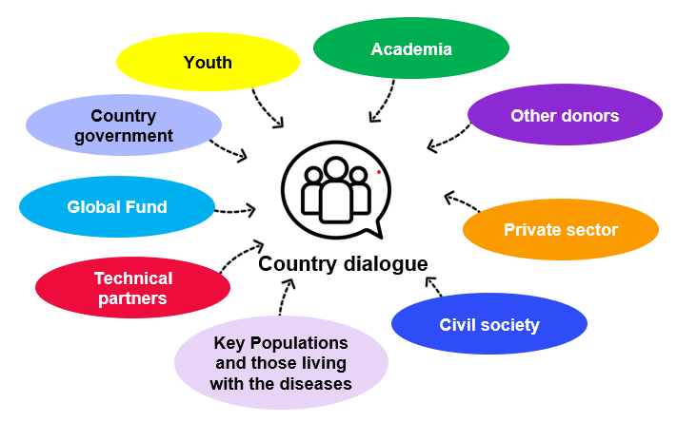
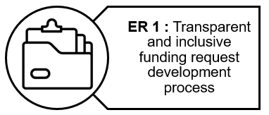
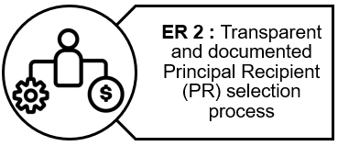
Country Dialogue
Expectations for Program Split
Secretariat will communicate allocation for HIV, TB, Malaria components
CCM Eligibility Requirements*
Countries will discuss program split during country dialogue
Countries will confirm their program split + indicative spending amount for RSSH
*screened at the time of submitting a funding request

Slide 10
Zambia Allocation Letter
Eligible Disease Component | Allocation (US$) | Allocation Utilization Period
HIV | 251,027,914 | 1 January 2024 to 31 December 2026
Tuberculosis | 21,508,410 | 1 January 2024 to 31 December 2026
Malaria | 77,243,020 | 1 January 2024 to 31 December 2026
Total | 349,779,344 | 1 January 2024 to 31 December 2026

Slide 11
Matching Funds and Strategic Initiatives
Zambia is eligible for the following catalytic Matching Funds:
US$3,000,000 for HIV pre-exposure prophylaxis (PrEP);
US$4,000,000 to find and successfully treat the missing people with drug-susceptible TB and drug-resistant TB; and
US$5,400,000 for effective community systems and responses (CS&R) contributing to improved health outcomes equitable access to integrated people-centered quality services.
Zambia is also eligible for the following catalytic Strategic Initiatives*:
integrated lab systems strengthening; and
effective CS&R contributing to improved health outcomes and equitable access to integrated people-centered quality services
Additionally, Zambia may be eligible for the in-country capacity building for procurement, quality assurance and supply chain Strategy Initiative* (*country inclusion will be discussed and finalized as part of country dialogue).

Slide 12
HIV prevention for key populations, AGYW and sexual partners priority area: HIV preexposure prophylaxis (PrEP) priority component (3 mUSD)
To access this Matching Fund (MF), Zambia must:
invest a portion of its HIV allocation that is at least 1.5 times greater than the amount of available Matching Funds, in PrEP-related prevention activities; and
maintain or increase the level of investment in HIV prevention activities from the country’s 2020-2022 HIV allocation, in its 2023-2025 HIV allocation.
Additionally, US$1,200,000 of the available Matching Funds amount for this priority area will be performance-based and can only be accessed by the country if sufficient progress, as determined by the Global Fund, has been made toward achieving the grant target for number of persons who received any PrEP product by June 2025.

Slide 13
Zambia’s HIV/TB funding request must also meet the following programmatic conditions, which will be evaluated by the TRP during its review:
Population size estimation for key populations and adolescent girls and young women has been conducted during the past three years or is planned and budgeted for in year one of the relevant 2023-2025 allocation period HIV grant. (Population size estimates are informed by UNAIDS guidance).
Expansion of service delivery platforms for and scale of HIV prevention program essentials is in place or planned and budgeted (e.g., availability of HIV prevention in family planning / sexual and reproductive health services, community-based and community-led organizations, pharmacies and other private sector outlets, and online service delivery).
Inclusion of a plan and budget for strengthened HIV prevention data systems.
Innovation or scale of HIV prevention outcomes.
HIV/STI prevention program stewardship and coordination that engages key stakeholders, especially priority populations and relevant critical multi-sectoral stakeholders in prevention program planning and decision making has been demonstrated.
Use of geographical and population-risk data to ensure targeting of PrEP offer to persons with high risk of HIV acquisition.
Inclusion of a plan and budget that includes more than one PrEP product option (oral, long acting injectable and/or the vaginal ring).
The minimum target for the full amount (initial and performance-based payments) is 82,200 number of persons on any PrEP product during the grant reporting period.

Slide 14
Find and treat the missing people with drug-susceptible TB (DS-TB) and drug-resistant TB (DR-TB) (4 mUSD)
To access this Matching Fund (MF), Zambia must:
invest a portion of its TB allocation that is greater than or equal to the amount of available Matching Funds, to find and treat people with DS-TB and DR-TB, focusing on specific interventions and/or populations to be agreed during country dialogue.
Zambia’s joint TB/HIV funding request must also meet the following programmatic conditions, which will be evaluated by the TRP during its review:
Scale up of innovative approaches to accelerate progress to find and treat the missing people with DS-TB and DR-TB, based on the country context and lessons learned.
Alignment of investments with priority interventions on TB screening and diagnosis outlined in the Global Fund’s TB Information Note.
Monitoring of progress in finding and successfully treating the missing people with DS-TB and DR-TB, including through the grant performance reporting.

Slide 15
Effective Community Systems & Responses (CS&R) contributing to improved health outcomes & equitable access to integrated people-centered quality services (5.4 mUSD)
Subject to funding confirmation, to access this Matching Fund (MF), Zambia must:
invest a portion of its total country allocation that is greater than or equal to the amount of available Matching Funds (i.e, at least a 1:1 match), in the eligible interventions for community health workers (CHW) programming and community systems strengthening (CSS) described in the Matching Fund component investment focus (which will be included in the Global Fund’s Matching Funds Guidelines 2023-2025, on the Global Fund’s website).
Zambia’s funding request must also meet the following programmatic conditions, which will be evaluated by the TRP during its review:
Demonstrated meaningful engagement of Ministry of Health (MoH) community health units, CHW/CHW associations, and community-led organizations (CLO)/community-based organizations (CBO) employing CHW in funding request development and grant making.

Slide 16
Inclusion of investments that are aligned with CHW and CSS guidance outlined in the Global Fund’s RSSH Information Note, as well as the eligible interventions outlined in the investment focus (which will be included in the Global Fund’s Matching Funds Guidelines 2023-2025, on the Global Fund’s website).
Submission of a completed CHW Programmatic Gap Table, aligned with national strategies and plans.
Inclusion of a Community Health Strategy (or plan to develop one) that integrates CHWs, community-led and community-based service delivery, including a costed operational plan.
Inclusion of an analysis or assessment and plans for strengthening systems components needed for effective CHW and CLO/CBO service delivery, including leadership and governance, workforce (including planning, training, remuneration and supervision), sustainable financing, digital tools and systems, supply chain, referral systems and community-led monitoring, as well as the capacity of the MoH and of CLOs/CBOs in service delivery.

Slide 17
Funding Request and PAAR: Continue to use NSP as foundation
National Strategic Plan(s)
Funding Request
With prioritized programmatic gaps
Prioritized Above Allocation Request (PAAR)

Slide 18
TRP review criteria and funding request submission dates
TRP review criteria for 2023-2025 allocation period
The Technical Review Panel assesses funding requests to ensure Global Fund investments are strategically focused, technically sound, poised for sustainability and have potential for impact.
Window | 2023 submission dates | 2023 TRP meetings | Notes
Window 1 | 20 March | 24 April – 5 May | Strongly recommended for countries with grants ending Dec 2023
Window 2 | 29 May | 3 July – 17 July
Window 3 | 21 August | 25 September – 6 October | Recommended for countries with grants ending in 2024
Ending AIDS, TB and malaria
Maximizing People-centered Integrated Systems for Health
Maximizing health equity, gender equality and human rights
Strengthening resource mobilization, sustainability, health financing, and value for money
Strengthening countries’ pandemic preparedness capabilities by building integrated and resilient systems for health

Slide 19
2023-2025 Application Package
* : If available
□ : If applicable
Funding Request Narrative
Performance Framework
Detailed Budget
Programmatic
Gap Tables
Funding Landscape Tables
Prioritized Above Allocation Request
Health Product Management Template □
RSSH Gaps & Priorities
Annex □
Gender Assessment*
Human Rights Assessment*
Essential Data Tables
National Strategic Plans
Innovative Financing Documentation □
Sustainability & Transition Supporting Documentation □
Implementation Arrangements
Map □
Funding Priorities from Civil Society & Communities
Country
Dialogue
Narrative
CCM Endorsement of Funding Request
CCM Statement of Compliance
Co-financing Documentation
Sexual Exploitation, Abuse and Harassment Risk Assessment*
+ List of Abbreviations & Annexes
Documents Not Reviewed by the Technical Review Panel

Slide 20
What’s New? : Annexes
Mandatory
Requested if available
Funding Priorities from Civil Society and Communities Annex
Sexual Exploitation Abuse and Harassment (SEAH) Risk Assessment
Country Dialogue Narrative Annex
Gender Assessment
RSSH Gaps & Priorities Annex
Assessments of Human Rights-related Barriers to Services
Updated: Essential Data Tables
TB and HIV program essentials are included here.

Slide 21
What’s New?
New Concepts & Abbreviations
PE
Program Essentials
GEM
Gender Equality Marker
SEAH
Sexual Exploitation, Abuse & Harassment
Integrated, People-Centered Systems for Health
PP
IPCSH
Pandemic Preparedness
CLR
Community-led and based responses
Notes:
Program Essentials: Standards for program design and coverage. Used to measure country progress towards WHO-recommended normative guidance.
Gender Equality Marker (GEM): Criteria set to establish a baseline for tracking and reporting on advancing gender equality.
Preventing Sexual Exploitation, Abuse and Harassment (PSEAH): To prevent and respond to SEAH related risks in Global Fund-financed programs. Will be required for 10 pilot countries.
Integrated People-Centered Systems for Health (IPCSH): Strengthening health services taking a user perspective, and supporting joined-up service delivery, particularly at local levels.
Pandemic Preparedness (PP): A subset of RSSH programming that is focused on the prevention of pandemics (i.e., not the response).
Community-led and based responses (CLR): Focus on scale-up of community-led and based responses across key intervention areas and as aligned with global plans
Funding Request Example: New guidance material providing concise examples of how the Funding Request questions could be answered.

Slide 22
Grant-making*
Best practices:
CCMs can confirm PR selection earlier in country dialogue to engage PRs in development of funding request documents, to accelerate grant-making (e.g., budget by PR)**
Strengthen civil society and community engagement in the grant-making process
PLAN
Translation of the funding request into quality grants, based on TRP recommendations, that are disbursement-ready for Board approval and signature and implementation-ready at the IP start date
NEGOTIATE
APPROVE
Changes to grant-making:
Publication of Funding Request following TRP recommendation for grant-making
Improvements to policy, process and system to embed GF strategy and gain efficiencies (details to come)
SIGN
GET READY
* Documented in the OPN and Operational Procedures on Make, Approve and Sign Grants to be published in December 2022.
** Recommended for FRs following the Program Continuation approach and continuing PRs.

Slide 23
Questions:
AccessToFunding@theglobalfund.org
Note: the Design and Review Funding Requests OPN is being updated for the 2023-2025 allocation period; CCMs and PRs will be notified in writing once the revised version has been approved and published

