Slide 1
Modular Framework
RSSH
Zambia CCM: 24 January 2023

Slide 2
Contents
 | Key Messages
 | Links to Other Guidance Documents and Global Guidance
 | Summary of Changes
 | Annex: Detailed Summary of All Changes
1
2
3
4

Slide 3
Key Messages
Rationale for New Indicators
Alignment with the Global Fund Strategy (2023-2028)
Emphasis on integrated people centered quality health services .
Includes new topics : health financing, private sector engagement, medical oxygen.
Added pandemic preparedness activities/interventions in 4 modules: lab systems, HRH and quality of care, M&E and medical oxygen.
  Labelled as RSSH/PP for easy identification and future tracking needs.
  Mapped to IHR/Joint External Evaluation (JEE) technical frameworks.
  Pandemic Preparedness-related activities included in other modules, but lighter touch.
Alignment with activities
in the HIV, TB and malaria sections of the
Modular Framework
Revised indicators and workplan tracking measures (WPTM) to allow for enhanced measurement of results
Addressed RSSH reporting and tracking needs

Slide 4


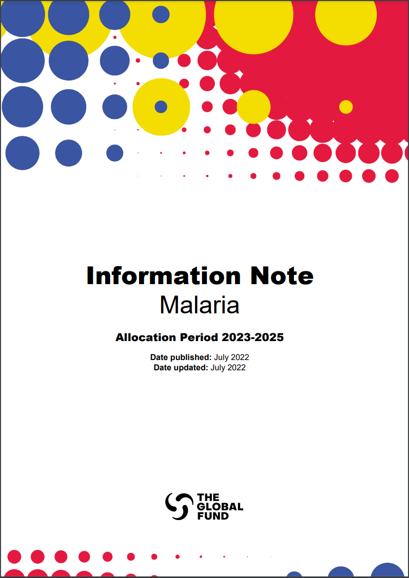
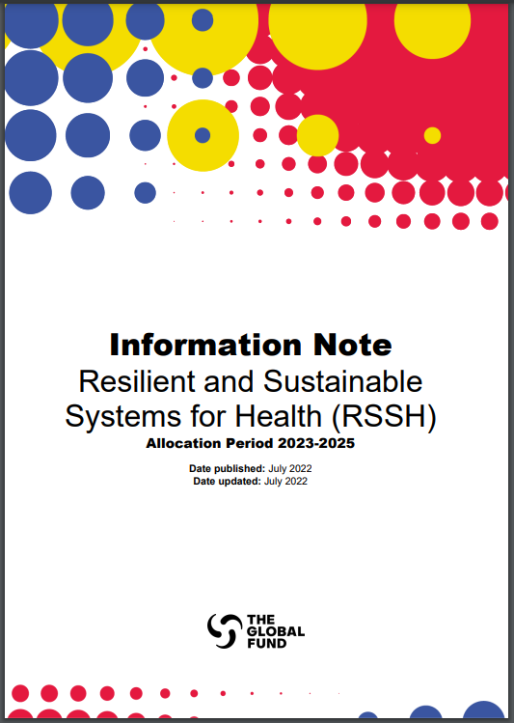

The Modular Framework is linked to other Global Fund application materials and reflects global guidance and metrics.
Information Notes
The RSSH Information Note provides guidance to applicants preparing funding requests for RSSH. Information Notes for HIV, TB and malaria are available here.
The Modular Framework is aligned with the revised Global Fund RSSH Information Note and the critical approaches described within this.
Additional Resources
1. Global Fund Strategy (2023-2028) (link)
With an emphasis on priorities for integrated people centered care.
2. Technical Briefs (link)
3. Global Guidelines
Current international guidance/guidelines including WHO recommendations
WHO highlights recommendations for the prevention and treatment of malaria in pregnancy (link)
Translations are in process for all Global Fund materials.

Slide 5
Summary of Changes: Updated RSSH Modules
2020-2022 Modules
Health sector planning and governance Integrated service delivery & quality improvement Financial management systems Community systems strengthening Health Products Management Systems Human resources for health and quality of care Laboratory systems Health management information systems & M&E
2023-2025 Modules
Health sector planning and governance for integrated people-centered services Community systems strengthening Health Financing Systems Health Products Management Systems Human resources for health and quality of care Laboratory systems Medical Oxygen and Respiratory Care Systems Monitoring and Evaluation Systems
Main changes: Two modules deleted (gray) and two new (green)
  Integrated service delivery and quality improvement module deleted → merged into HRH and quality of care
  Financial management systems module deleted → merged into (New!) Health Financing Systems
  (New!) Medical oxygen and respiratory care systems module

Slide 6
Summary of Changes (by Module)
Health Governance
Total of 8 RSSH modules and
52 interventions
Includes a new intervention to support private sector engagement by capturing legal, regulatory, TA & capacity building activities
Health Product Management
Emphasizes integrated health products management systems and new ‘critical approaches’
Community System Strengthening
Stronger focus on people-centered interventions with explicit emphasis on “community-led” activities (e.g., community-led monitoring.)
Monitoring & Evaluation Systems
Emphasizes integrated and/or interoperable M&E systems, aligned with new M&E critical approaches
NEW
Health Financing
Includes development and implementation of health financing strategies and plans, plus innovative health financing strategies.
HRH &
Quality of Care
Includes two new interventions focused on quality of care, aligned with new HRH critical approaches, including planning for sustainability
Medical Oxygen & Respiratory Care
Supports oxygen and respiratory care systems.
Laboratory Systems
Reflects pandemic preparedness and emphasizes integration of lab investments, governance and innovation

Slide 7
Summary of Changes
RSSH Indicators: Evolved to focus on integrated people-centered quality health services (IPCQS)
From: metrics to measure RSSH investment inputs and outputs, isolated from HIV, TB and malaria
To: metrics to measure Integrated, people-centered quality services outcomes linked with HIV, TB and malaria results
Have we done the activities as planned? (e.g., training conducted)
Are key inputs available? (e.g., active health workers per 10,000 population)
Are key services (not linked with HIV, TB and malaria) provided? (e.g., diagnostic, antenatal care)
How did our investments enhance integrated services across HIV, TB, malaria and beyond?
How did our investments improve quality of care?
How did we advance the systems that matter for HIV, TB, malaria and PP outcomes?
22 new indicators &
13 discontinued indicators
Measure progress on strategy-related objectives:
  Measure outcome/s of investments on IPCQS
  Encourage implementors to shift focus from short term health system support to long term health system strengthening.

Slide 8
Summary of Changes: RSSH Outcome Indicators
Previous 2020-2022 RSSH Outcome Indicators | (New) 2023-2025 RSSH Outcome Indicators
Active health workers per 10,000 population (HSS O-8) | Systems readiness index for CHWs (RSSH/PP O-1)
National aggregate HMIS fully deployed and functional: Percentage of HMIS components in place (HIS deployment, completeness, timeliness, and integration of aggregate disease reporting for HIV, TB and malaria indicators) (HSS O-7) | Digital HMIS maturity profile score (RSSH/PP O-2)
Percentage of antenatal clients with 1st visit before 12 weeks (HSS O-9) Percentage of facilities providing diagnostic services on the day of the assessment (HSS O-6) | Percentage of facilities providing HIV, TB and malaria integrated services to pregnant women. (RSSH O-1)
Proportion of population with large household expenditure on health as a share of total household expenditure or income (catastrophic spending on health) (HSS O-10) | Percentage of population with large household expenditure on health as a share of total household expenditure or income (catastrophic spending on health). (RSSH O-2)
Percentage of health facilities with tracer medicines for the three diseases available on the day of the visit or day of reporting (HSS-05) | On-Shelf Availability: Percentage of facilities with tracer health products for the three diseases- HIV, TB, malaria (as applicable) available on the day of the visit or day of reporting. (RSSH O-3) Maturity level of the national medical products regulatory system. (RSSH O-4)

Slide 9
Thank you

