Slide 1
Updates to HIV Information Note, including Program Essentials and Critical Approaches
Guidance for the 2023 – 2025 allocation period (Grant Cycle 7)
Zambia CCM – 24th January 2023

Slide 2
Key HIV Resources

Slide 3
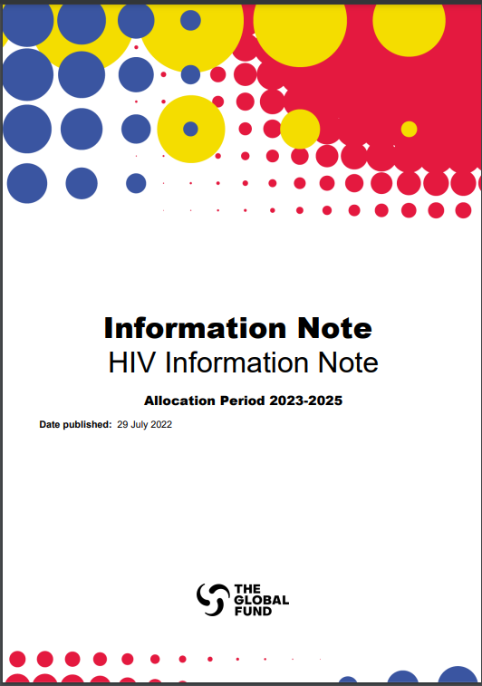
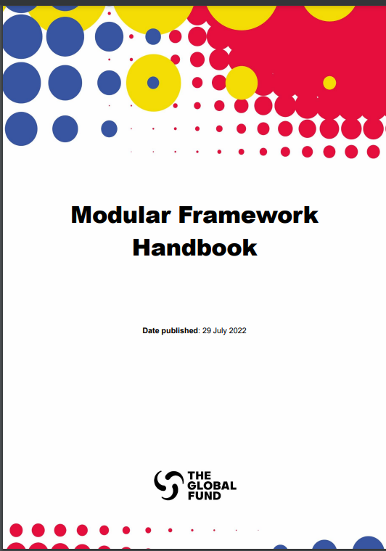

Key HIV Resources for Funding Requests
Updates for the 2023-2025 Allocation Period
HIV Information Note
The RSSH, TB and Malaria Information Notes are also available here.
Additional Resources
1. Technical Briefs
Technical Briefs will be published here as they are finalized in Q4 2022. These resources will include additional detail on specific topics (HIV Service Delivery in COE, Health & Longevity, HIV, Human Rights and Gender Equality).
2. Global Guidelines
Links to all key technical guidance documents are in footnotes of the HIV Information Note.
Modular Framework
This resource includes details on Global Fund-supported interventions and indicators.
Translations are in process for all Global Fund materials.
Notes:
In the 2023-2025 allocation period, there are new opportunities to leverage advances in HIV prevention and treatment and to adopt precision public health approaches. There is also a need for continued attention to addressing inequities and human rights- and gender-related barriers to services, to support integration between HIV services and related areas of health and to strengthen the health systems that support a wider range of services

Slide 4

Key Changes to HIV-related materials
Updates for the 2023-2025 Allocation Period
Essential Data Tables
Alignment with new Global Fund Strategy, along with other global strategies and updated global guidelines
Includes information on Program Essentials, Priority Interventions and Country examples
Access the HIV Information Note here.
Streamlining of HIV modules and interventions
Updated indicators aligned with strategy and WHO/UNAIDS M&E
Access the Modular Framework here.
Additional baseline data (and disaggregates) which is pre-filled by Global Fund, where available.
Program Essentials table is to be completed by applicant.
Notes:
The Global Fund will put a greater focus on equity, sustainability, program quality and innovation.

Slide 5
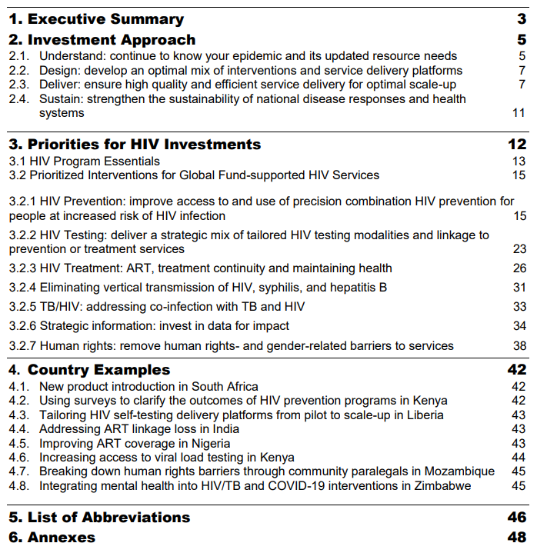
HIV Information Note - Contents
Revised structure

Slide 6




HIV Investment Approach
2.1 Understand
2.2 Design
Know your epidemic and its updated resource needs
Analyze the current and evolving epidemiological context
  Perform HIV cascade data analysis
  Understand and update unit cost estimates
  Analyze the partner landscape
Prioritize an optimal mix of interventions and service delivery platforms
Involve stakeholders in program design
Prioritize programs, services and platforms that most efficiently use resources and that maximize use and impact of the services
2.3 Deliver
2.4 Sustain
  Ensure high quality and efficient service delivery for optimal scale-up
  Accelerate adoption and scale-up of novel health products,* technologies and service delivery innovations
  Maximize efficiencies and systems integration, and ensure people-centered health services
  Ensure standards related to human rights and protection from sexual exploitation, abuse and harassment are met for all Global Fund-supported programs and services
  Differentiate programming in Challenging Operating Environments
  *Table 1
  Strengthen the sustainability of national disease responses and health and community systems
Incorporate sustainability considerations throughout the grant life cycle.
Sustainability, Transition & Co-Financing (STC) Policy

Slide 7
Table 1. Products and technologies for introduction and scale-up in
Global Fund-supported programs
Product Area | Objective | Products
Diagnostics/ screening for HIV | Improve case finding, accelerate self-care and prevention | HIV self-testing Early infant diagnosis (EID), including at point of care
Diagnostics/ screening for coinfections and comorbidities | Accelerate rapid diagnosis of important coinfections and comorbidities | Diagnostics for advanced HIV disease, especially fungal and next generation lateral flow urine lipoarabinomannan assay (LF-LAM)​ Dual HIV/Syphilis rapid diagnostic tests (RDT) Multi-disease RDTs: sexually transmitted infections (STI)/HIV/Hepatitis Multi-disease molecular testing: TB/Hepatitis/HIV/drug resistance​ Human papillomavirus (‎HPV)‎ nucleic acid amplification tests (‎NAATs)‎ for screening Hepatitis C self-tests
Prevention HIV | Expand choice, accelerate self-care, enable people- centered services | Pre-exposure prophylaxis (PrEP) – dapivirine vaginal ring and long-acting injectable cabotegravir Long-acting opioid substitution therapy (OST)
Management HIV treatment and care | Achieve early and sustained viral suppression | Dolutegravir-based regimens, including 10mg dolutegravir for children Point of care (POC) technologies for viral load measurement, including early infant diagnosis (EID)​ Point of care CD4 count testing (Visitect)
Prevention and management Coinfections and comorbidities | Optimize HIV management to reduce morbidity and mortality | TB preventive therapy: 3HP [isoniazid (INH) and rifapentine (RPT)] ​ Hepatitis B vaccine (within 24 hours of birth) Human papillomavirus vaccine Hepatitis B and C antiviral drugs Liposomal amphotericin B (single high dose) for Cryptococcal infection
Devices/ technology | Accelerate differentiation and digital and virtual service delivery for people-centered services | Use of virtual interventions, including the use of both telephone and internet-based platforms to reach and engage clients in HIV testing, prevention, and treatment.
 | Enhance public health surveillance and response | Rapid survey tools Geo-mapping (mapping using geospatial data)
Notes:
In the 2023-2025 allocation period, there are new opportunities to leverage advances in HIV prevention and treatment and to adopt precision public health approaches.

Slide 8
Program Essentials

Slide 9
Introduction to Program Essentials
What are they?
How were they selected?
Program Essentials are key evidence-based interventions and approaches to address the ambitious goals set out in the HIV, TB, and Malaria global strategies.
When part of national programs, Program Essentials will support countries to achieve their national targets. They can be funded by either The Global Fund or other sources.
Elements recommended by technical partners (WHO, UNAIDS, Stop TB, RBM)​ and further described in their respective technical guidelines
Critical interventions needed to achieve outcomes and impact set out in global strategies (WHO, UNAIDS, Stop TB, RBM and the Global Fund)
Crucial to ensure equity in access to highly impactful interventions

Slide 10



How Will Program Essentials Be Used in Grant Cycle 7*?
How will Program Essentials be used to meet this objective in the new funding period?
To achieve global goals for HIV, TB and malaria using the Global Fund strategy and its Program Essentials as enablers, whether through Global Fund grants or other means
Overall objective
1
Countries will be asked to outline their “level of advancement” toward achieving the Program Essentials and identify any gaps (see Essential Data Table).
2
Countries will determine which actions to address unmet Program Essentials should be included in their funding request, guided by country and disease context.
>
3
Where countries have prioritized the introduction and acceleration of Program Essentials in funding requests, the Global Fund – subject to TRP / GAC review – will support countries in achieving and sustaining them.
4
The Global Fund will assess progress against the Program Essentials through existing indicators (as relevant) and monitoring processes.

Slide 11
Program Essentials should be incorporated in the routine country dialogue / prioritization process
Illustrative
Prioritized interventions discussed during country dialogue
Interventions included in the funding request
All Program Essentials
PAAR
All other eligible interventions (based on Information Notes)
Interventions addressing unmet Program Essentials
Supported during grant-making, implementation, and monitoring (subject to TRP review and GAC approval)
All other eligible interventions included in the funding request
Country dialogue determines which unmet program essentials & other interventions to include in funding request during prioritization process

Slide 12
Program Essentials will play a critical role in the grant life cycle, vary by country and disease
Grant life cycle | Steps to address Program Essentials | Applicable countries
Country dialogue | Program Essentials offer a platform for discussion among key country stakeholders; applicants actively review them during country dialogue, assess country progress against them, and identify implications for their programs | All countries
Funding request | Applicants outline their level of advancement in achieving the Program Essentials in either the Essential Data Tables (HIV & TB) or the funding request narrative (Malaria) | All countries
 | Applicants incorporate actions to address unmet Program Essentials in their funding request (or PAAR), where identified through the country dialogue & the country’s prioritization process | All countries
 | Applicants describe any plans to address Program Essentials that are not considered addressed in the funding request narrative | HI & Core only
 | TRP reviews progress toward fulfilling Program Essentials and alignment with the funding request | All countries
Grant-making | Where grants fund interventions to address the Program Essentials, PRs embed them into the relevant grant-making documents (i.e., detailed budget, performance framework, implementation mapping) | All countries
 | GAC reviews incorporation of Program Essentials in the grant-making documents | All countries
Implementation and tracking | Where interventions are included in the grants that address Program Essentials, their progress will be reviewed via relevant indicators in the portfolio review process, and routine portfolio update | All countries

Slide 13
Frequently asked questions on Program Essentials
Must countries use Global Fund grants to address or make progress towards achieving Program Essentials?
No. Actions targeted at the Program Essentials could also be directly funded by the country’s national disease programs or by other partners / entities. The decision on whether Program Essentials will be included in Global Fund Funding Request should be made during the prioritization process (refer to HIV, TB, Malaria and RSSH Information notes for the respective lists of prioritized interventions).
What happens if a country’s disease program does not fulfill the Program Essentials?
Program Essentials offer a platform for discussion with national programs and other country stakeholders on critical elements recommended by technical partners. While some of the Program Essentials may not be addressed initially, applicants are expected to make progress toward fulfilling them over time. TRP reviews will include level of advancement in fulfilling PEs. For High Impact and Core countries, TRP will also review plans to fulfill Program Essentials.
How should countries use Program Essentials during country dialogue?
Countries will review the Program Essentials and assess their level of advancement toward each of them. This is an opportunity for country stakeholders, including technical partners, to review country policies and the need to further align them with global technical recommendations. During the prioritization process, countries should consider including actions in their funding request to address any unmet Program Essentials, guided by their particular country and disease context.
Will progress against Program Essentials be tracked throughout the grant life cycle?
Where interventions are included in the grants that address Program Essentials, their progress will be reviewed via relevant indicators in the portfolio review process, and routine portfolio update
Are there also Program Essentials for RSSH?
No. In view of the differing challenges and priorities for The Global Fund’s RSSH investments, the RSSH team has developed a set of ‘Critical Approaches’ that are conceptually and operationally distinct from Program Essentials. More information about ‘Critical Approaches’ can be found in the RSSH Information Note.

Slide 14
Program Essentials for HIV (1 of 2)
HIV Information Note (Table 2)
HIV primary prevention | Condoms and lubricants are available for all people at increased risk of HIV infection Pre-exposure prophylaxis (PrEP) is available to all people at increased risk of HIV infection, and post-exposure prophylaxis (PEP) is available for those eligible Harm reduction services are available for people who use drugs ​ Voluntary medical male circumcision (VMMC) is available for adolescent boys (15+ years) and men in high HIV incidence settings
HIV testing & diagnosis | HIV testing services include HIV self-testing, safe ethical partner (index) and social network-based testing ​ A three-test algorithm is followed for rapid diagnostic test-based diagnosis of HIV ​ Rapid diagnostic tests are conducted by trained and supervised lay providers ​in addition to health professionals
Elimination of vertical transmission | Antiretroviral treatment (ART) is available for pregnant and breastfeeding women living with HIV to ensure viral suppression HIV testing including early infant diagnosis (EID) is available for all HIV-exposed infants
HIV treatment & care | Rapid ART initiation follows a confirmed HIV diagnosis for all people irrespective of age, sex or gender HIV treatment uses WHO-recommended regimens HIV care includes management of advanced HIV​ Support is available to retain people across the treatment cascade including return to care CD4 and viral load testing, and diagnosis of common comorbidity and coinfections are available for management of HIV

Slide 15
Program essentials for HIV (2 of 2)
HIV Information Note (Table 2)
TB/HIV | People living with HIV with active tuberculosis (TB) are started on ART early TB preventive therapy is available for all eligible people living with HIV including children and adolescents ​​​
Differentiated service delivery (DSD) | HIV services (prevention, testing, treatment and care) are available in health facilities, including sexual and reproductive health services, and outside health facilities including through community, outreach, pharmacy and digital platforms Multi-month dispensing is available for ART and other HIV commodities ​
Human Rights | HIV programs for key and vulnerable populations integrate interventions to reduce human rights- and gender-related barriers Stigma and discrimination reduction activities for people living with HIV and key populations are undertaken in health care and other settings Legal literacy and access to justice activities are accessible to people living with HIV and key populations Support is provided to efforts, including community-led efforts, to analyze and reform criminal and other harmful laws, policies and practices that hinder effective HIV responses

Slide 16
Discussion, Q &A – programme essentials
Any areas where you have feedback / questions in terms of programme essentials?
Where are there policy barriers? / Are these supported in policy and guidelines?
What are the implementation barriers? / Degree to which implemented?
What do you see as the data gaps? For which are you most interested in auditing / measuring these?

Slide 17
HIV Prioritized Interventions (1 of 5)
Priority Area
HIV prevention:
Improving access to and use of precision combination HIV prevention for people at increased risk of HIV infection – requires good strategic data
Interventions and approaches to prioritize
Expand coverage of combination HIV prevention for key populations and their sexual partners in all epidemic settings
Expand coverage of combination HIV prevention for AGWY and men in settings with high HIV incidence
Expand service delivery platforms for HIV prevention
Expand and integrate human rights interventions into HIV prevention
Strengthen HIV prevention program stewardship

Slide 18
What else is new for prevention?
Measurement guidance for Global Fund Supported HIV Prevention programs
2020 Thematic Review on HIV Primary Prevention (2020) indicated a lack of overarching framework and approach to measuring results
Need to enhance monitoring and evaluation efforts to effectively demonstrate progress towards the objective of ensuring that 95% of people at risk of HIV use combination prevention;
Need to look at more proximal outcomes as well as outputs; the prevention outcomes monitoring tool – e.g. sampling / pooling / virtual / case based / FGD.
file:///C:/Users/ashroufi/OneDrive%20-%20The%20Global%20Fund/Documents/Prevention/Prevention%20monitoring%20framework/Prevention%20framework%20-%20Global%20Fund.pdf
Notes:
Recent findings from Technical Evaluation Reference Group (TERG) Thematic Review on HIV Primary
Prevention (2020) indicated a lack of overarching framework and approach to measuring results
citing inconsistencies in reporting and monitoring of Global Fund supported HIV prevention
programmes in countries and recommends that guidance could be improved to address this gap.
This Global Fund HIV prevention Results Frameworke clarifies the relationships between input (investment), outputs (coverage), and outcomes (use, behaviour) for HIV impact. It highlights the importance of focusing on a set of primary outcomes that are proximal to the reduction of new HIV infections.

Slide 19
Discussion - Prevention
Prevention priorities for next funding application? / Any particular areas where support needed?
How do you see service delivery points / platforms for prevention evolving in Tanzania?
In terms of low coverage of KPs for prevention are there challenges here / investment priorities for next cycle?
Targets for PrEP in the next cycle and any support needed in terms of introducing PrEP commodities – Ring and CAB LA. Forecasting brining in different use strategies.

Slide 20
HIV Prioritized Interventions (2 of 5)
Priority Area
HIV Testing:
Deliver a Strategic Mix of Tailored HIV Testing Modalities and Linkage to Prevention or Treatment Services
Interventions and approaches to prioritize
HIV testing strategy based on routine and frequent review of HIV testing data
A strategic mix of differentiated HIV testing services that includes facility-based testing, community-based testing, HIV self-testing, as well as social network-based and safe ethical partner testing
A three-test strategy, which reduces the risk of false positive results by requiring three consecutive reactive test results to receive an HIV-positive diagnosis
The inclusion of HIV self-testing as part of the strategic mix of HIV testing services
The use of dual HIV/syphilis rapid diagnostic tests as first test in HIV testing algorithms for pregnant women
HIV testing programs should aim for high testing coverage for people at increased risk of HIV infection, such as key populations in all settings, and AGYW and their male sexual partners in high HIV incidence settings
The review/modification of policies on parental consent for HIV testing (and self-testing) for adolescents
Early infant diagnosis (EID) for children exposed to HIV and linkage to care: Countries should map and optimize laboratory networks to ensure appropriate placement of both conventional and point of care (POC) technologies
Safe, ethical, and voluntary index testing should be offered to all people living with HIV, prioritizing newly diagnosed people living with HIV and those who are not virally suppressed
The integration of point of care CD4 testing in HIV testing services
Linkage to services: Interventions should link people across all ages, sex/gender, and risk categories to the services they need
Task shifting. Lay workers and peers can safely perform HIV testing and are important in increasing access to HIV testing, particularly among key and vulnerable populations
The use of virtual interventions, including the use of both telephone and internet-based platforms to reach and engage clients in HIV testing.

Slide 21
Discussion - Testing
Country plans for addressing pediatric testing and treatment in the next cycle?
Lessons learned from self testing investments so far?
Experience gained from different distribution strategies?
Country priorities in terms of the introduction of new / previously little used testing commodities?

Slide 22
HIV Prioritized Interventions (3 of 5) ART & EMTCT
Priority Area
HIV Treatment: ART and Treatment Continuity Maintaining Health
Interventions and approaches to prioritize
Accelerate and optimize antiretroviral treatment
Support health and longevity among people living with HIV
Deliver differentiated services for HIV treatment and care
Priority Area
Elimination of Vertical Transmission: HIV & Syphilis and Hepatitis
Interventions and approaches to prioritize
Integrated HIV testing and rapid ART initiation among pregnant and breastfeeding women including adolescents and key populations at facility and community service delivery points
Treatment continuity and retention of the mother-infant pair throughout the breastfeeding period
Prevention of new HIV infections among pregnant and breastfeeding women
Infant prophylaxis
Early infant diagnosis and follow-up HIV testing for infants through the breastfeeding period and linkage to paediatric HIV treatment
Integrated service delivery with SRH and maternal, neonatal and child health (MNCH)

Slide 23
Section 3.2.4 Eliminating Vertical Transmission of HIV, syphilis and hepatitis (previously titled PMTCT)
The Global Fund supports the recommendation of the “triple elimination initiative” to use an integrated approach to eliminate vertical transmission of HIV, syphilis, and hepatitis B. Shift in framing and explicit inclusion of Hep B testing and treatment among pregnant women in line with WHO guidance
Integrated HIV testing and rapid ART initiation among pregnant and breastfeeding women including adolescents and key populations at facility and community service delivery points Treatment continuity and retention of the mother-infant pair throughout the breastfeeding period Prevention of new HIV infections among pregnant and breastfeeding women Infant prophylaxis Early infant diagnosis and follow-up HIV testing for infants through the breastfeeding period and linkage to paediatric HIV treatment Integrated service delivery with SRH and maternal, neonatal and child health (MNCH) HIV, syphilis and hepatitis B testing at first ANC visit per national protocols linkage to appropriate and prompt treatment, within sexual and reproductive health service delivery platforms, reflecting a comprehensive approach to a pregnant woman’s most important health needs NOTE: More details will be provided in the Prioritization Framework for Supporting Health and Longevity among People Living with HIV to be online by Nov/Dec 2022

Slide 24
Discussion - Treatment
Pediatric and Adult ART optimization – any challenges encountered and priorities for the next funding cycle?
Any lessons learned or areas for further discussion in terms of differentiated service delivery?

Slide 25
HIV Prioritized Interventions (4 of 5)
Priority Area
TB/HIV: Addressing Co-infection
Interventions and approaches to prioritize
HIV testing for all people with TB
ART initiated as soon as possible within two weeks of initiating TB treatment, regardless of CD4 cell count for people diagnosed with HIV.
Cotrimoxazole preventive treatment and TB treatment for people living with HIV with active TB.
Systematic screening for TB disease among people living with HIV at each contact with facility and community health services and integrated in DSD models.
For TB diagnosis, WHO-recommended rapid molecular assays should be used as the first diagnostic test.
Tuberculosis preventive treatment (TPT) for all eligible people living with HIV.
Where services are provided in prisons, systematic screening for TB disease.

Slide 26
Discussion – addressing co-infections
Programme priorities in terms of HIV-TB integration?
TPT scale up – any feedback in terms of the TPT SI work?
Prospects and plans in terms of the introduction of 3HP regimen for TPT?

Slide 27
Supporting Health and Longevity among People People Living with HIV
Addressing AHD, Viral Hepatitis, Cervical Cancer, NCDs and Mental Health

Slide 28
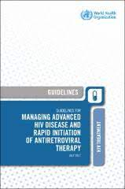
Advanced HIV Disease
Support to all necessary commodities
CD4 cell count testing
Cryptococcal Meningitis, prevention, diagnosis, treatment
TB – TPT, Cotrimoxazol optimization, enhanced diagnosis
Histoplasmosis – diagnosis and treatment
Enhanced patient and community support

Slide 29
Support in terms of managing other comorbidities
Within HIV service delivery platforms
Viral Hepatitis – integrated testing and treatment within HIV service delivery platforms
Cervical cancer – screening and diagnosis, secondary prevention for PLWHIV and at risk, where strong investment case
NCDs and Mental health – screening for PLWHIV, support for integration efforts
Notes:
Noting fiscal constraints and need for strong investment case

Slide 30
Discussion on comorbidities and coinfections
Current levels of access to CD4 testing? Role of visitect / network optimization?
Progress and challenges in urinary TB LAM roll out?
Challenges / progress in terms of the roll out of decentralized CrAg screening? Progress in getting flucytosine / liposomal amphotericin B into the country?
Challenges / progress in getting clinicians to adopt the use of flucytosine? /
Lessons learned from cervical cancer programme and anticipated needs in next funding cycle? E.g. in terms of integrated management?

Slide 31
HIV Prioritized Interventions (5 of 5)
Priority Area
Strategic Information: Data for Impact
Interventions and approaches to prioritize
Routine cascade data reviews
HIV case surveillance and patient monitoring to enable effective clinical management of patients and to generate data for program monitoring
Detailed HIV expenditure analysis
Bio-behavioral surveys (BBS) and population size estimates (PSE) among key and vulnerable populations
Monitoring HIV Prevention Programs
Data Quality Assessments (DQA)
HIV Drug Resistance (HIVDR) Surveillance
People Living with HIV Stigma Index
Community-led monitoring
Priority Area
Human Rights: Remove Human Rights- and Gender-related Barriers to Services
Interventions and approaches to prioritize
Eliminate stigma and discrimination in all settings
Ensure non-discriminatory provision of health care
Improve legal literacy (“know-your rights”)
Increase access to justice
Ensure rights-based law enforcement practices
Improve laws, regulations and polices relating to HIV and HIV/TB
Reduce HIV-related gender discrimination, harmful gender norms and violence against women and girls
Community mobilization and advocacy for human rights

Slide 32
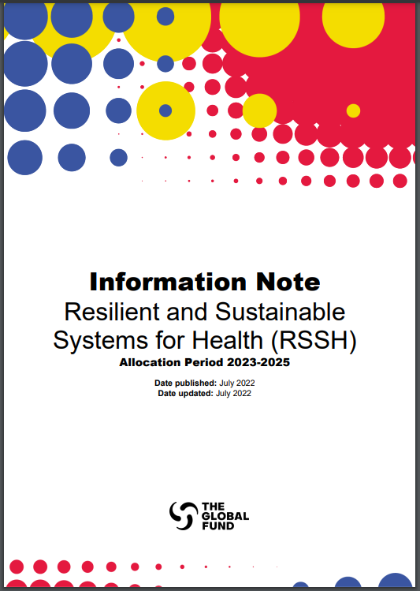

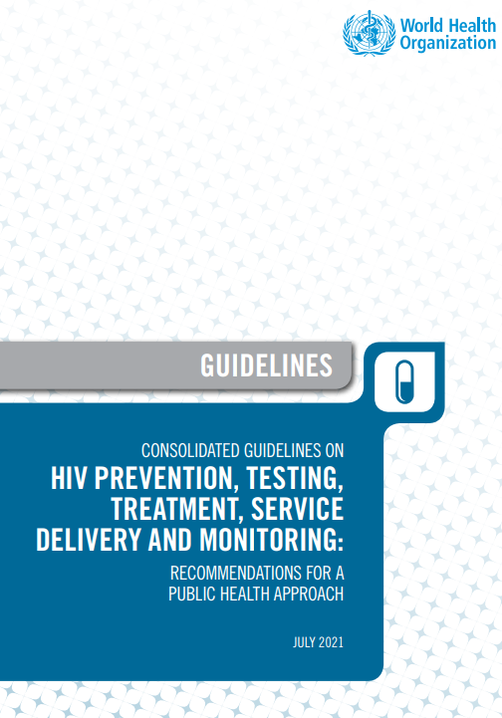
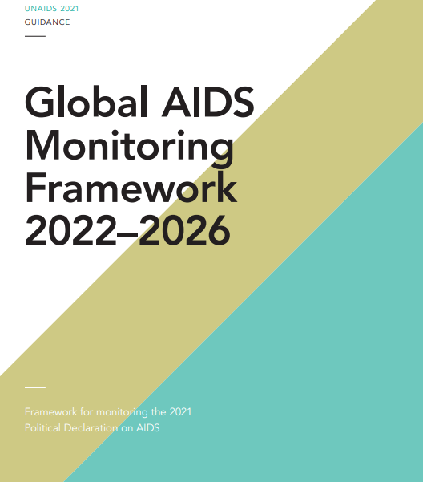
The Modular Framework is linked to/builds on other guidance documents and reflects global guidance and metrics
Technical Brief
Information Notes: Guidance to applicants preparing funding requests for HIV and joint tuberculosis (TB)/HIV programs and for RSSH (Links: HIV; RSSH).
Technical Briefs provide additional detail in specific areas (e.g., HIV services in Complex Operating Environments, Maintaining Health and Longevity, etc.) (Link).
Modules and interventions in the Modular Framework reflect global guidelines, strategies (Link).
Updated indicators in the Modular Framework are aligned with Global AIDS Monitoring Framework and WHO HIV monitoring indicators (Link).

Slide 33
HIV Modular Framework Updates
Alignment with the Global Fund Strategy (2023-2028)
Alignment with global HIV standards and strategies
Updated language, activity descriptions and indicators to align with new global HIV strategies and technical recommendations.
Move to greater precision public health.
Intensified, tailored and targeted high-impact prevention investments; focus on prevention outcomes aligned with Prevention Theory of Change.
Innovation in programs.
Advanced HIV Disease.
Continued focus on equity, human rights and gender.
Enable tracking of budget dedicated to key strategy areas.
Adapted to accommodate future HIV landscape.
The Global Fund Strategy (2023-2028) is an enabler to achieve global goals. Countries adapt their responses according to country/epidemiologic context.
Further
Streamlining
Address duplication and overlaps
Updated reporting system to improve budget data quality.
Modules/Interventions:
85 interventions. (Reduced from 136 in 2020-2022).
Removal of duplication and overlaps.
Indicators:
22 new indicators (10 related to human rights).
18 indicators updated.
5 indicators discontinued.
Disaggregation streamlined.

Slide 34
Summary of changes by module (1)
Module | Key changes
Prevention | Structural change: Moved back to an “NFM2-like structure”, prevention modules structured by priority populations, including 5 KPs and their sexual partners, adolescent girls and young women (AGYW) and their male sexual partners (MSP), and Other vulnerable populations. Structural change resulted in the removal of the population tab from the detailed budget template. Consistent list of interventions across all populations – with tailored additions for people who use drugs (both injecting and non-injecting), people in prison/detention/closed settings and AGYW/MSP. Streamlining include merging components of the COIM intervention with SRH intervention and removing harm reduction as a stand-alone intervention (kept only for prisoners). AGYW and MSP are included under the same prevention module with dedicated interventions. Budget can be allocated to AGYW and/or MSP. Added a new prevention module (Prevention program stewardship) with a focus on strengthening national prevention program stewardship.
Elimination of vertical transmission of HIV, syphilis and hepatitis B | List of interventions is completely new. Transformed the former PMTCT module, moved beyond the 4 prongs and focused on program & interventions delivered through MNCH platform. Aligned to triple elimination of vertical transmission (including Syphilis/Hepatitis B). Doesn’t include treatment for pregnant women anymore, that will be budgeted entirely in the Treatment, Care and Support module (HIV treatment and differentiated service delivery - Adults [15 and above]).

Slide 35
Summary of changes by module (2)
Module | Key changes
Differentiated HIV Testing Services | Structural change: Shift from population to program approach to improve data quality. From 32 interventions in the 2020-2022 cycle to 9 in the 2023-2025 cycle. Allow to track budget by priority populations: KP programs, AGYW programs and programs outside of KPs and AGYW; by service delivery modality: Facility-based testing, community-based testing, self-testing. Index testing is captured as part of other testing modalities. Early Infant Diagnosis (EID) and Testing for Pregnant women is captured under the Elimination of vertical transmission module (former PMTCT).
Treatment, care and support | Program approach to facilitate reporting and budget disaggregation and better track pediatric treatment. Relevant change: Split between adult and children now required in “HIV treatment and care” intervention. New intervention: “Diagnosis and management of Advanced disease (adults and children)”. Treatment monitoring ARV toxicity merged with Viral load intervention
TB/HIV | Reduced list of interventions – going from 12 interventions in the 2020-2022 cycle to 6 in the 2023-2025 cycle (e.g., TB/HIV KPs merged into one intervention; Collaborative activities with other programs and sectors (TB/HIV) and TB/HIV collaborative activities merged under one; Engaging all care providers removed.
Reducing human rights-related barriers to HIV/TB services | No changes in the intervention list. Update of language.

Slide 36

Overview of HIV Modules and Interventions in the 2023-2025 Allocation Period
Prevention:
7 modules by population
(5 KPs + OVP + AGYW & male sexual partners)
+ 1 module (Prevention program stewardship)
Differentiated HIV Testing Services
Elimination of vertical transmission of HIV, syphilis & hepatitis B
(Former PMTCT)
Treatment, care and support
One testing module that includes a combination of service delivery modalities and programs:
Facility testing
Community testing
Self-testing
…in programs targeting:
KPs programs (not disaggregated)
AGYW programs
Non KPs/Non AGYW programs
* EID and antenatal care (ANC) included in Elimination of vertical transmission module
Testing of pregnant women for HIV, HBV, syphilis (ART and COIM treatment under treatment module)
HIV prevention among HIV negative pregnant and breastfeeding women
Post-natal prophylaxis for HIV-exposed infants
EID and follow-up HIV testing for exposed infants
Retention support to HIV-positive pregnant and breastfeeding women (facility and community)
HIV treatment and differentiated service delivery - Adults (15 and above)
HIV treatment and differentiated service delivery - Children (under 15)
Treatment monitoring – HIV drug resistance
Treatment monitoring - Viral load and ARV toxicity
Integrated management of common coinfections and comorbidities (adults and children)
Diagnosis and management of advanced disease (adults and children)
List of repeated priority interventions distributed by modules (by population)
Specific to PUD (injecting and non-injecting)
Needle and Syringe programs, incl. hepatitis B (HBV) and hepatitis C (HCV)
Opioid Substitute Therapy (OST) and other medically assisted drug dependence treatment
Overdose prevention and management
Condom and lubricant programing
PrEP programming
HIV prevention communication: information and demand creation
SRH services, including STIs, hepatitis B, post-violence care
Community empowerment
Removing human rights-related barriers to prevention
Prisoners only: Harm reduction as a stand-alone intervention
Specific to AGYW & male sexual partners in high incidence settings
Social protection interventions
Comprehensive sexual education (CSE) for AGYW and adolescent boys and young men (ABYM)
Voluntary medical male circumcision
TB/HIV
TB/HIV collaborative activities
Screening, testing and diagnosis
Treatment
Prevention
Community TB/HIV care delivery
TB Key populations
Reducing human rights-related barriers to HIV/TB services
Community mobilization and advocacy for human rights
Increasing access to justice
Ensuring nondiscriminatory provision of health care
Legal literacy
Improving laws, regulations and polices relating to HIV and HIV/TB
Reducing HIV-related gender discrimination, harmful gender norms and violence against women and girls in all their diversity
Ensuring rights-based law enforcement practices
Eliminating stigma and discrimination in all settings
+ Cross-cutting Modules
(i.e. RSSH, Program Management)

Slide 37





2023-2025 Allocation Period Timeline
2022
2023
2024
2025
Q1 | Q2 | Q3 | Q4
Q1 | Q2 | Q3 | Q4
Preparation of FR templates, instructions, guidance materials
Published application materials (July)
E-learnings/Webinars/
Trainings (Sept-Dec)
Allocation letters
(Dec)
Funding Request Submissions (from March)
+ TRP review windows
Legend
FR application materials
Grant-making activities
Allocation letters
FR submission and review
Board Meetings
Grant Implementation
Grant-making
Replenishment Conference
Grant Implementation

Slide 38
Discussion – final points
Overall priorities for the next funding request?
Any help and / or analysis that could support?
Any other areas where you feel further support would be helpful?
Comments and feedback for HIV team?

Slide 39
Fight for What Counts theglobalfund.org/en/fight-for-what-counts

